Slide 1



Fujitsu Selects a SaaS Solution to Simplify the Sales Process
IS 501 Introduction to Information Systems
Case Study
30 December 2020
Instructor:
Pekin Erhan Eren
Group Members:
Rüstem Ozan Özdemir
Doğukan Göksu
Ömer Öztürk

Slide 2






01
Company Introduction
02
Challenges
03
Previous Sales and Ordering System
04
FPX CPQ
05
Build or Buy CPQ?

Slide 3


Company
Company Introduction
Challenges
Previous Sales and Ordering System
Build or Buy CPQ?
Why FPX CPQ?
Network communications company
Widely used in North America
Products:
Optical and wireless networking equipment
Servers
Client computing devices
Storage products
Leading patent holder

Slide 4
01
Company Introduction
02
Challenges
03
Previous Sales and Ordering System
04
FPX CPQ
05
Build or Buy CPQ?

Slide 5
Challenge
Company Introduction
Challenges
Previous Sales and Ordering System
Build or Buy CPQ?
Why FPX CPQ?
Large number of parts and innumerable configurations
Large variety of pricing
Complex network sites

Slide 6
01
Company Introduction
Şirketin Kısa Tanıtımı
Hissedarlar
02
Challenges
03
Previous Sales and Ordering System
04
FPX CPQ
05
Build or Buy CPQ?

Slide 7

Previous System
Company Introduction
Challenges
Previous Sales and Ordering System
Build or Buy CPQ?
Why FPX CPQ?
Individual spreadsheet
No centralized repository
Long time CPQ process, quoting errors and corrections

Slide 8
01
Company Introduction
Şirketin Kısa Tanıtımı Proje İçeriği
02
Challenges
Şirketin Kısa Tanıtımı Proje İçeriği
03
Previous Sales and Ordering System
04
FPX CPQ
05
Build or Buy CPQ?

Slide 9

CPQ OnDemand
Company Introduction
Challenges
Previous Sales and Ordering System
Why FPX CPQ?
Build or Buy CPQ?
Cloud-based CPQ software
Salesforce lead management and forecasting software
Fujitsu’s ERP system
Other advantages

Slide 10
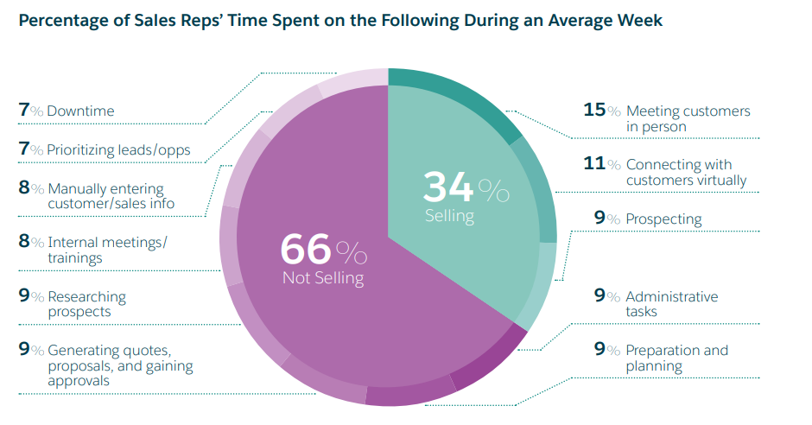
Impacts of CPQ OnDemand
Company Introduction
Challenges
Previous Sales and Ordering System
Why FPX CPQ?
Build or Buy CPQ?
80% reduce in pricing errors
Reduce in overall cycle time
More important information
Real-time solutions

Slide 11
01
Company Introduction
Şirketin Kısa Tanıtımı Proje İçeriği
02
Challenges
Şirketin Kısa Tanıtımı Proje İçeriği
03
Previous Sales and Ordering System
Şirketin Kısa Tanıtımı Proje İçeriği
04
FPX CPQ
05
Build or Buy CPQ?

Slide 12

Build or Buy CPQ
Company Introduction
Challenges
Previous Sales and Ordering System
Build or Buy CPQ?
Why FPX CPQ?
Pros of Building
Control
Unique Fit
Lower Immediate Costs
Vision of Company
Cons of Building
Outdated Software
Long Development Time
Limited Training and Support
Risks

Slide 13
Company Introduction
Challenges
Previous Sales and Ordering System
Build or Buy CPQ?
Why FPX CPQ?
Build or Buy CPQ
Pros of Buying
Software Sophistication
Stable Knowledge Base Lower
Continuous Improvement
Streamlined Functionality
Cons of Buying
Higher Upfront Cost
Less Control
Security issues

Slide 14
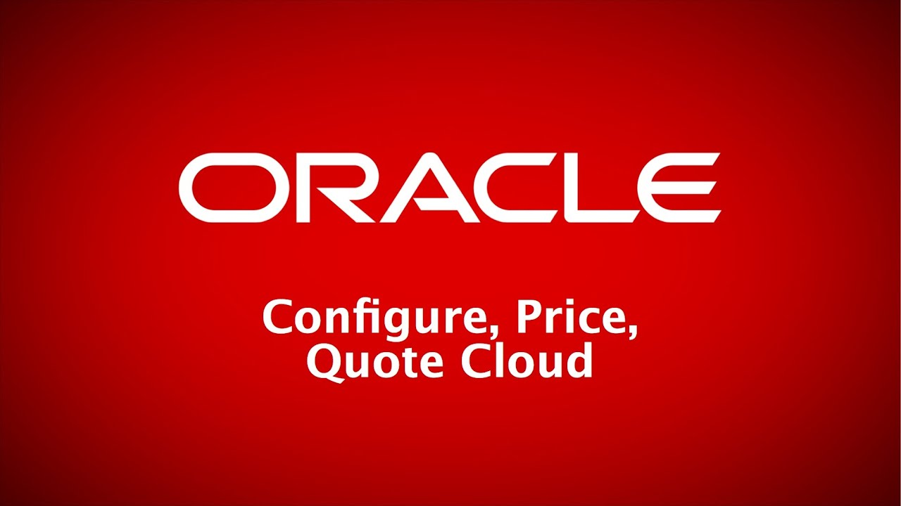


CPQ in Turkey
Company Introduction
Challenges
Previous Sales and Ordering System
Build or Buy CPQ?
Why FPX CPQ?

Slide 15
References
www.fujitsu.com
Laudon, K.C., Laudon, J.P.(2014). Management Information System: Managing the Digital
Salesforce Research, State of Sales Third Edition(2018)
https://www.kofana.com/tr
https://pm.stackexchange.com/questions/12113/how-should-we-assess-build-vs-buy-for-an-erp-system
https://www.cincom.com/insights/stat-fact-sheet/build-vs-buy-seven-factors-influencing-your-cpq-decision

Slide 16
THANKS

